Slide 1

Pattern
Patent
Notes:
# only scratched the surface of the data for the limited time and resources

Slide 2
Let’s Pattern USPTO Patents

Slide 3
Are you thinking filing patents on your own?
Is your company looking for a patent agent/attorney?
Would you afford the time cost?
Is your case likely to be patented?
Which attorney are you talking to?
Would you want to live around other inventors?
Do you know the examiner’s comfort zone?
Notes:
My motivations: workflows at work

Slide 4
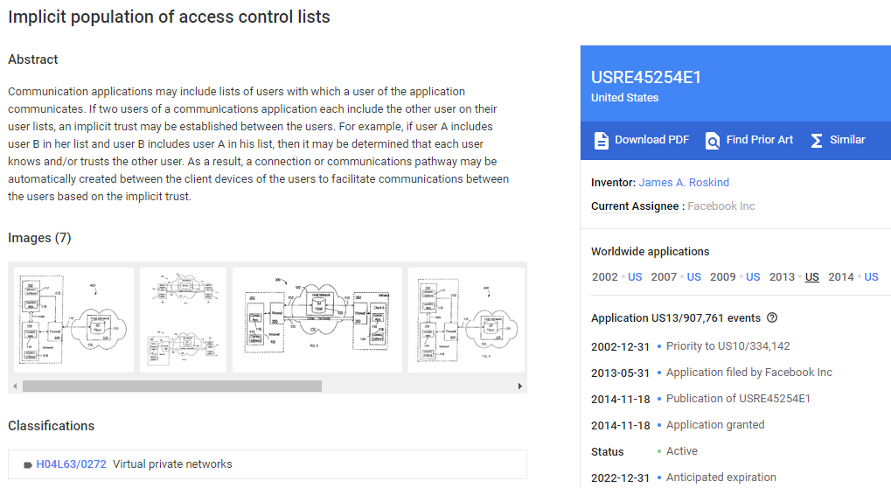
https://patents.google.com/patent/USRE45254

Slide 5
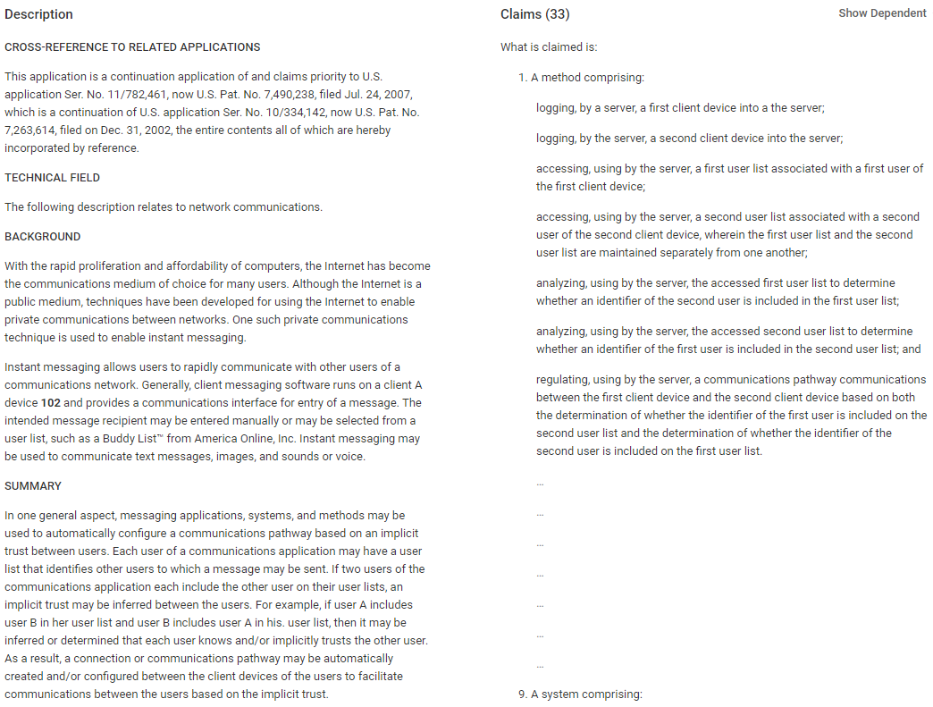
https://patents.google.com/patent/USRE45254

Slide 6
.csv used in this project – Raw Data
patent_claims_stats
75,930,664 rows
application_data
15,494,295 rows
all_inventors
27,446,246 rows
attorney_agent
224,145,534 rows
Data Source
https://www.uspto.gov/learning-and-resources/electronic-data-products/patent-examination-research-dataset-public-pair
https://www.uspto.gov/learning-and-resources/electronic-data-products/patent-claims-research-dataset
Notes:
Valuable objective data from USPTO. Deferent from doctors reviews: it can be subjective and hard to judge if a doctor is a good doctor. There are stupid doctors out there (no offense).
# # only scratched the surface of the data for the limited time and resources

Slide 7
application_data
application_data.csv

Slide 8
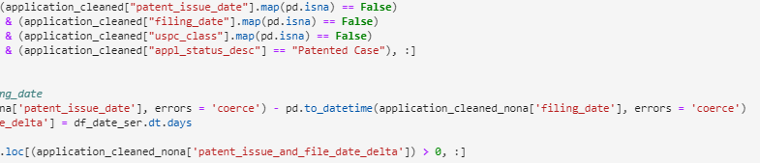
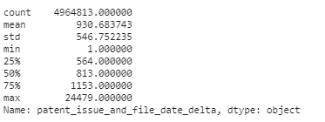
application_data.csv
Study days between patent issuing and filing
patent_issue_date: Latest 2020-04-21 – good data set!
application_cleaned_nona
(4,964,813 rows)
“patent_issue_and_file_date_delta”
2.55 years
Notes:
Strict requirements when setting up DataFrame to avoid input errors!

Slide 9
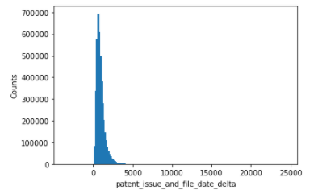
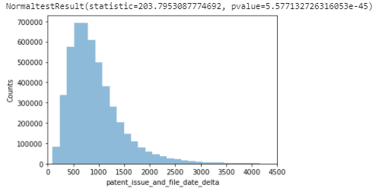
application_data.csv
Outliers
Reject the null hypothesis. Data doesn't seem to be normal. Right skew.
Notes:
When you perform a statistical test, you have two hypothesis:
the null hypothesis. Often call H_0. In your case, the null hypothesis is that the data comes from a Normal distribution.
the alternate hypothesis. Often call H_1 or H_A. In your case, the data comes from a non-normal distribution.
# A small p-value indicates that the observations are inconsistent with the Null hypothesis. The typical phrase used is, "we reject the null hypothesis". That means that your data doesn't seem to be normal.

Slide 10
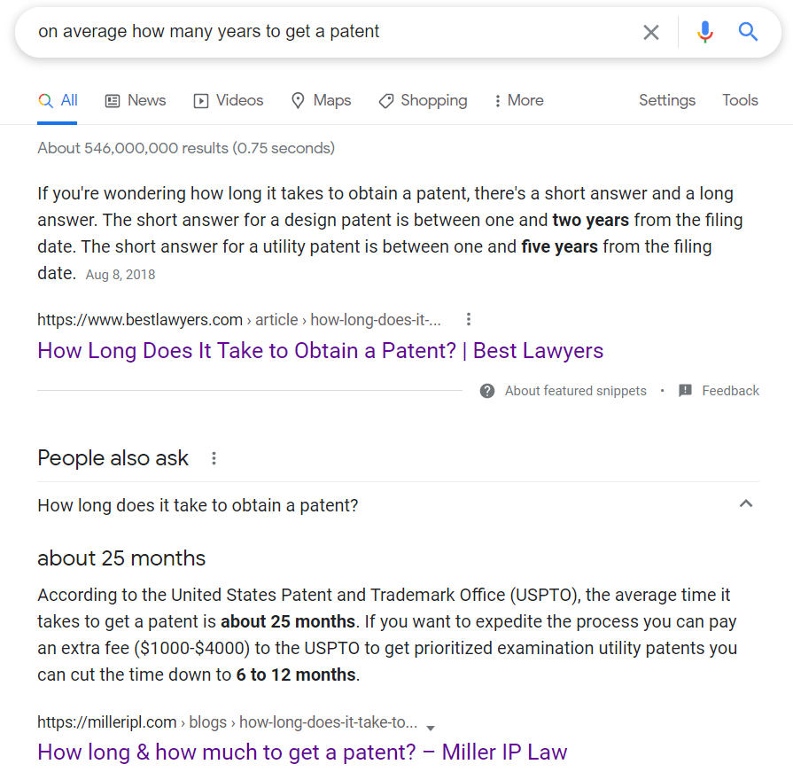
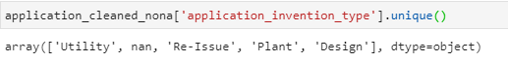
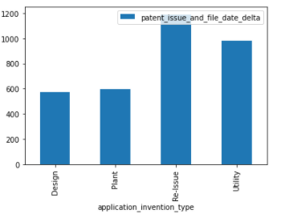
application_data.csv
I trust USPTO and my own data analysis
2.693 years
1.578 years

Slide 11
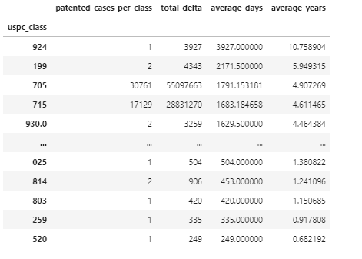
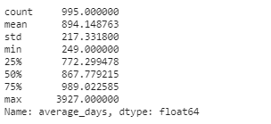
How about “patent_issue_and_file_date_delta” under each uspc_class?
application_data.csv
Notes:
Sorted by days above .
# The mean here is smaller than the mean in previous slide because some applications do not have a uspc_class logged. Groupby drop the NaN.

Slide 12
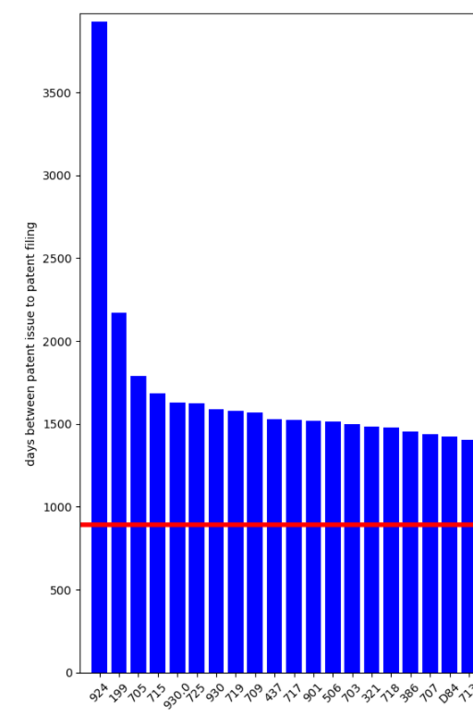
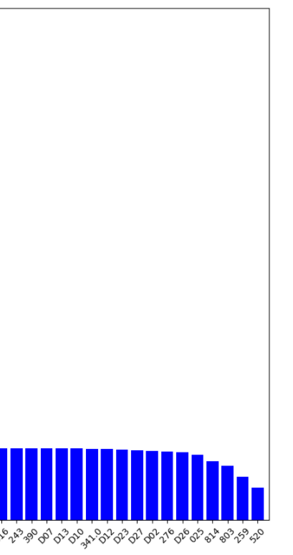
Type casting
Data processing: financial, business practice, management, or cost/price determination
Data processing: presentation processing of document, operator interface processing, and screen saver display processing
Interactive video distribution systems
Peptide or protein sequence
Electrical computers and digital processing systems: interprogram communication or interprocess communication (ipc)
Environmental heating and cooling; fluid handling and sanitary equipment
Tobacco and smokers' supplies
Apparel and haberdashery
Typesetting
Faster
Lighting
Synthetic resins or natural rubbers
application_data.csv
Notes:
Workflows take lots time. Weird rare class take shorter time.
# So far you should have an understanding how long it takes to file your uspc_class on average. Do you want to wait that long to get a patent?

Slide 13
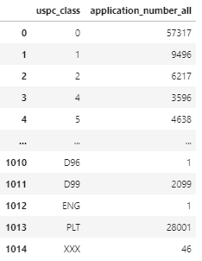
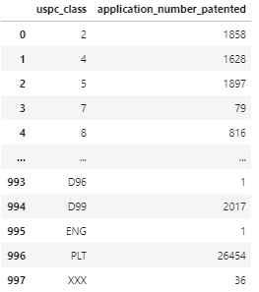
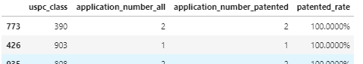
Study patented rate
.groupby('uspc_class').sum()
.agg({"patented_cases_per_class": "sum"})
Lessons and learn:
Use small dataset to test on.
Manually calculate on one uspc_class and compare.
Two incoming DataFrames are from “application_cleaned “, only filtered by different criteria, so data is accurate.
application_data.csv
Notes:
Two top DataFrames are from same base Dataframe so data is accurate.

Slide 14
uspc_class.sort_values(["patented_rate"], ascending = False)
application_number_all
patented_rate
application_number_all stacked with application_number_patented
combined
Notes:
application_number_patented takes part of application_number_all

Slide 15
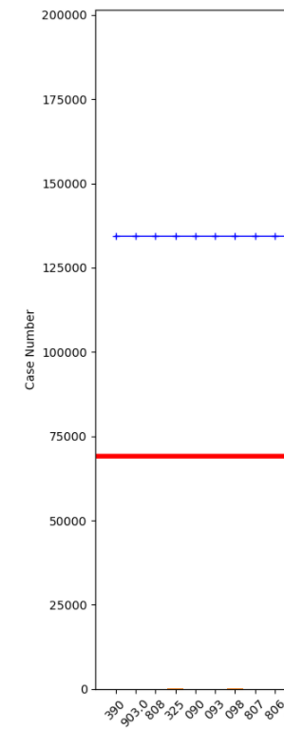
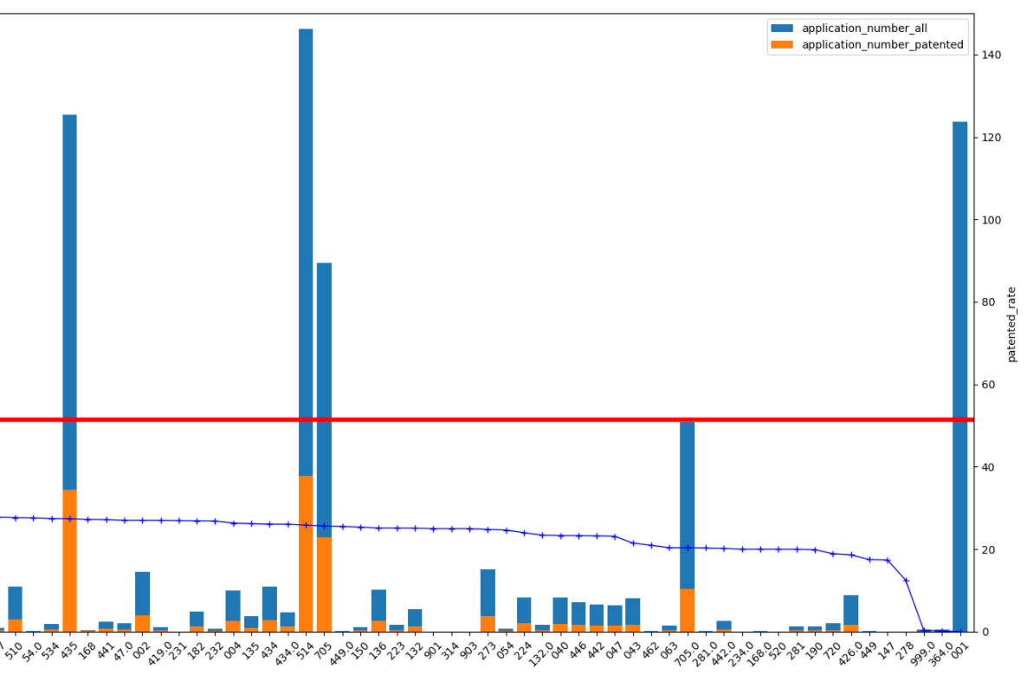
Checkout where your uspc_class stand.
application_data.csv
Notes:
Red is the mean for the average patented rate.
# Checkout where your uspc_class stands.
# It can be meaningless to check on the 100% patented classes if their application cases are only a few.
# So lets check on the patented rate for the uspc_class which receives large amounts of applications.

Slide 16
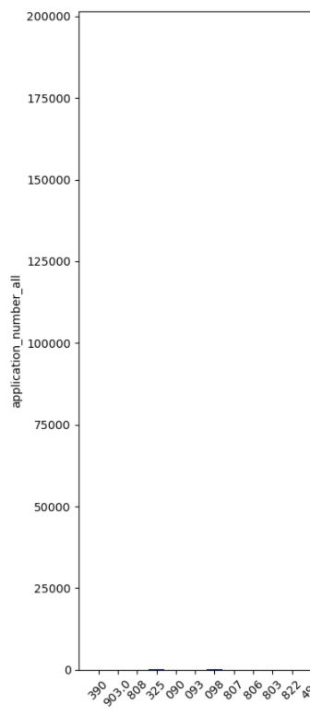
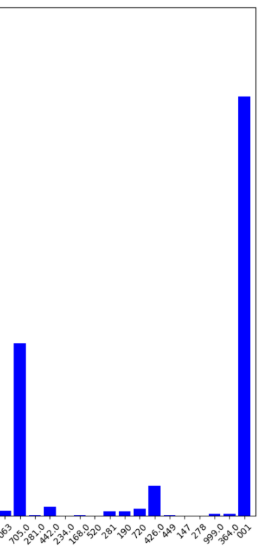
total application numbers by uspc_class
Drug, bio-affecting and body treating compositions
Needle and pin making
Chemistry: molecular biology and microbiology
Hybrid electric vehicles (hevs)
Drug, bio-affecting and body treating compositions
Coopering
Multiplex communications
Whips and whip apparatus
Active solid-state devices (e.g., transistors, solid-state diodes)
Type casting
LEAST
Stock material or miscellaneous articles
Data processing: financial, business practice, management, or cost/price determination
This one also takes long time as we just reviewed!
Telecommunications
Computer graphics processing and selective visual display systems
Semiconductor device manufacturing: process
MOST
application_data.csv
Notes:
Check out some of the most applied uspc_class
# This one also takes long time as we just reviewed! WHY??
# If someone takes your method, implement it using some language, compile it and commercialize the executable, then there is no way for you to find it out

Slide 17
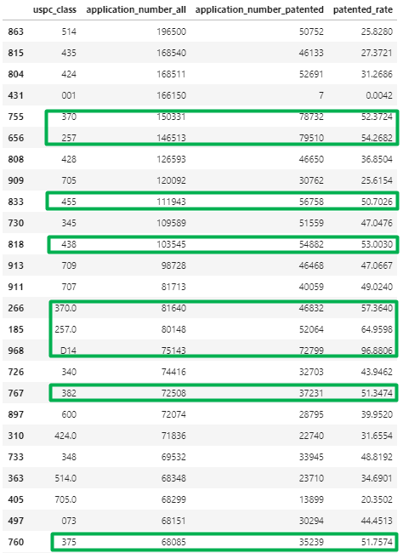
.sort_values(["application_number_all", "patented_rate"], ascending = [False, False])
Drug, bio-affecting and body treating compositions
Chemistry: molecular biology and microbiology
Multiplex communications
Active solid-state devices (e.g., transistors, solid-state diodes)
Data processing: financial, business practice, management, or cost/price determination
Telecommunications
Semiconductor device manufacturing: process
Multiplex communications
Active solid-state devices (e.g., transistors, solid-state diodes)
Recording, communication, or information retrieval equipment
Image analysis
Pulse or digital communications
application_data.csv
Notes:
.sort_values(["application_number_all", "patented_rate"], ascending = [False, False]).
# Patented_rate and application_number_all are Not correlated, just looking at it. Do not even need to draw a line.
# Point it out bio-chem has low patented rate. That is why big pharm companies keep merging small ones. Hard for small company to survive! The eco’logical situation for pharm companies.
# Green circled ones are over 50 success rate.
# Data processing: financial, business practice, management, or cost/price determination also has a low patented rate. So why so many applications???

Slide 18
My Interests
D25
Building units and construction elements
D12
Transportation
074
Machine element or mechanism
052
Static structures (e.g., buildings)
405
Hydraulic and earth engineering
application_data.csv
Notes:
My Interests

Slide 19
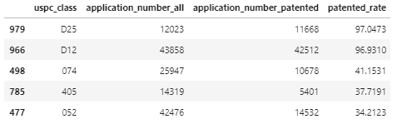
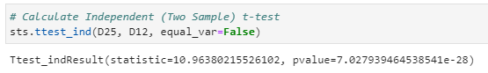
My Interests
Building units and construction elements
Transportation
Machine element or mechanism
Hydraulic and earth engineering
Static structures (e.g., buildings)
D25 and D12 have close patented rate,
check on their property: patent_issue_and_file_date_delta with Independent t-tests
application_data.csv
Notes:
#p-value is very small, so can reject the null hypo D25 and D12 mean are the same from the patent_issue_and_file_date_delta perspective.
# We can use this test, if we observe two independent samples from the same or different population, e.g. exam scores of boys and girls or of two ethnic groups. The test measures whether the average (expected) value differs significantly across samples.
# If we observe a large p-value, for example larger than 0.05 or 0.1, then we cannot reject the null hypothesis of identical average scores. If the p-value is smaller than the threshold, e.g. 1%, 5% or 10%, then we reject the null hypothesis of equal averages.

Slide 20
Make an App (SQL, PowerApp)
One Step Further:
Are you applying for patent? Take your risk!
Under interested class:
Would you afford the time cost?
Is your case likely to be patented?
application_data.csv

Slide 21
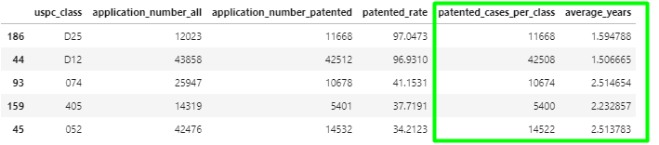
Merge filing period DataFrame with patented rate DataFrame
Hamlet App
application_data.csv
Notes:
Average years only 1.6 years and I will take it!!! With a high patented rate
# the application_number_patented and patented_cases_per_class are not exactly the same from the two DataFrames, why?
# application_number_patented is generated from (application_cleaned_patented.groupby(['uspc_class']) which has looser requirements since only want to know the final result if patented or not.
# patented_cases_per_class is generated from (application_cleaned_nona.groupby(['uspc_class'])) which has stricter requirements since it was calculating period.
The soliloquy is essentially all about life and death: "To be or not to be" means "To live or not to live" (or "To live or to die"). Hamlet discusses how painful and miserable human life is, and how death (specifically suicide) would be preferable, would it not be for the fearful uncertainty of what comes after death

Slide 22
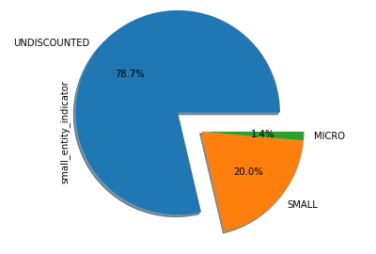
Are you a small entity applying for patent?
Small entity
typically a nonprofit organization or a company with fewer than 500 employees
entitles the applicant to a 50 percent discount on most fee payments to USPTO.
micro entity
Qualify as a USPTO-defined small entity,
Not be named on more than four previously filed applications,
Not have a gross income more than three times the median household income from the previous year
Not be under any obligation to assign, grant, or convey a license or other ownership to another entity that does not meet the micro entity requirements above entitles the applicant to a 75 percent discount
https://www.uspto.gov/learning-and-resources/fees-and-payment/uspto-fee-schedule
application_data.csv

Slide 23
attorney_agent
attorney_agent

Slide 24
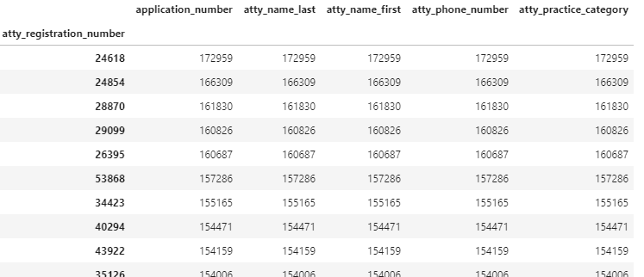
Meet the top richest attorneys
.groupby(['atty_registration_number']).count().sort_values(['application_number'], ascending = False).head(10)
attorney_agent
Notes:
# some applications may not have been logged the attorney info. Above has 48406 rows. 24618 24854 28870 29099 26395 53868

Slide 25
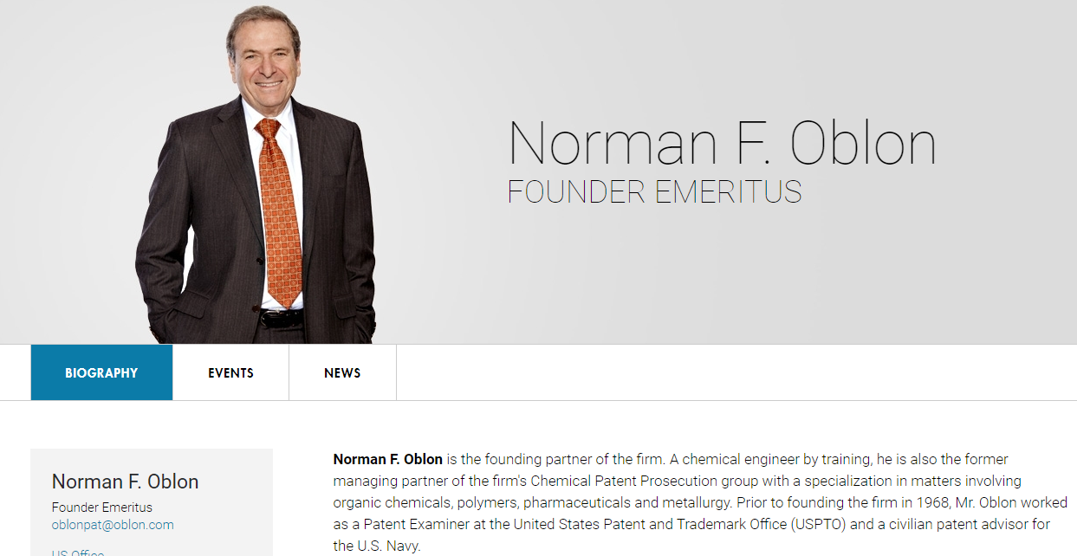
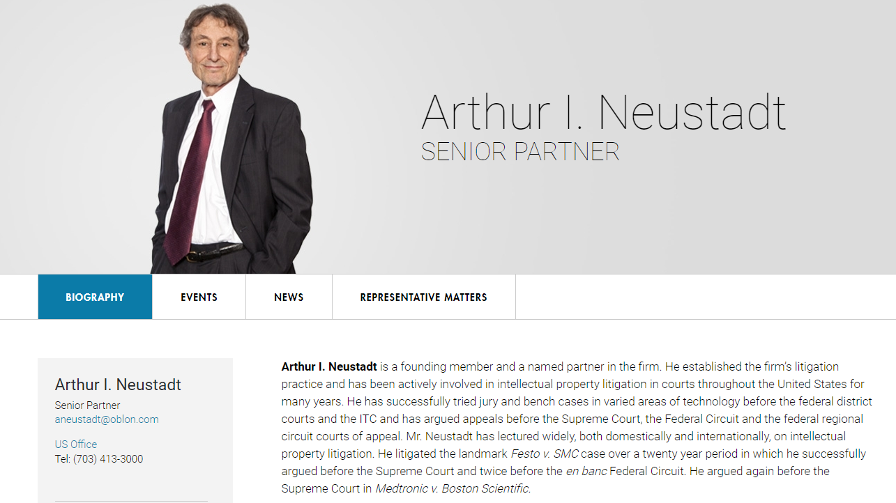
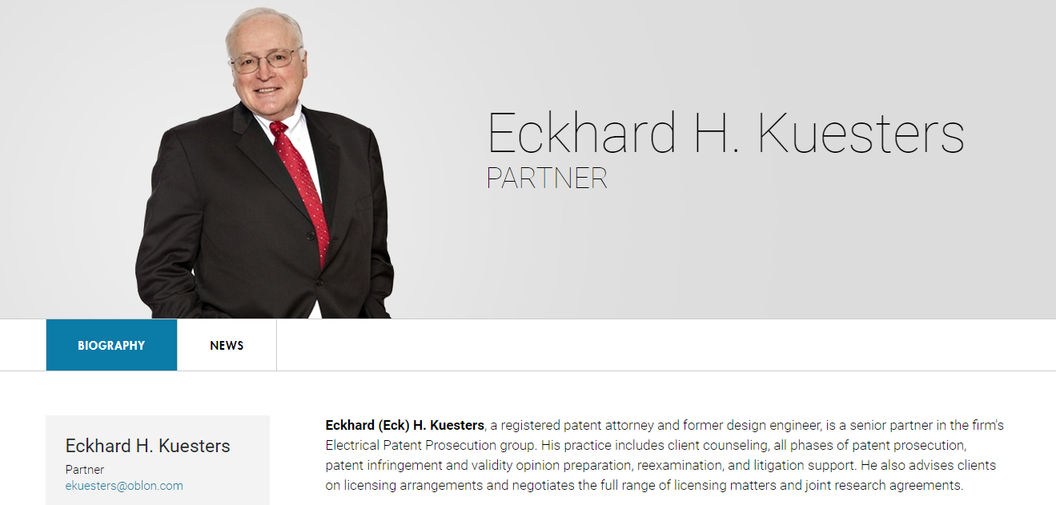
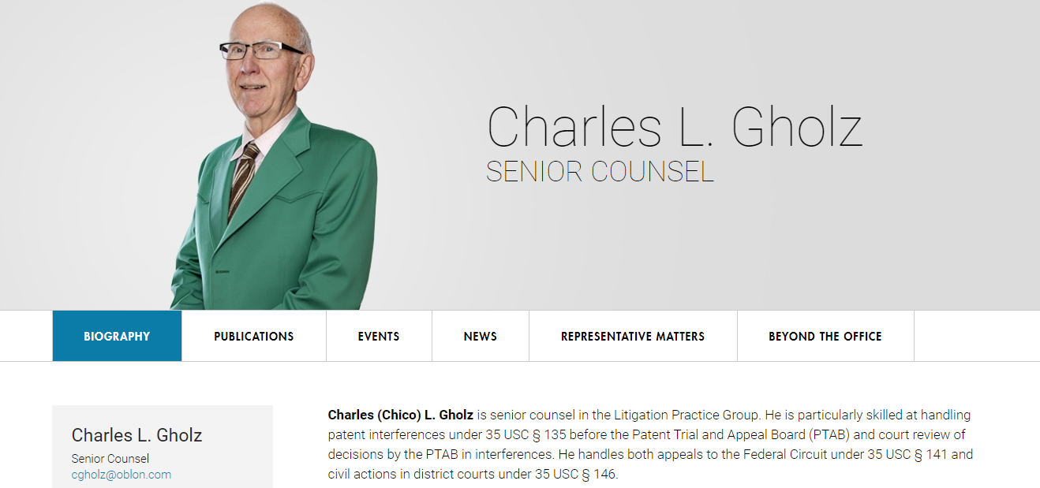
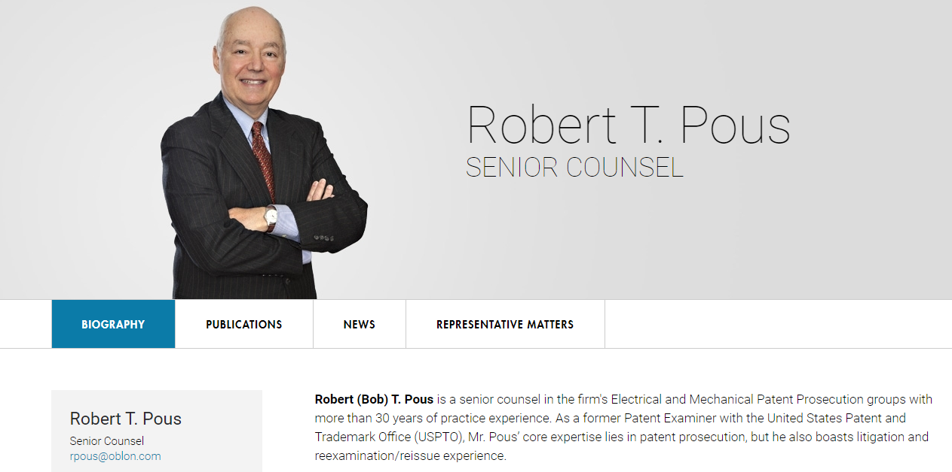
Find any common features of the top richest attorneys across all USPTO ??
How about their successful rate?
Picture source-https://www.oblon.com/
attorney_agent
Notes:
Top 5 attorneys who applied most cases

Slide 26
Find any common features of the top richest attorneys across all USPTO ??
How about their successful rate?
44.14%
46.80%
46.85%
47.18%
47.04%
Picture source-https://www.oblon.com/
attorney_agent

Slide 27
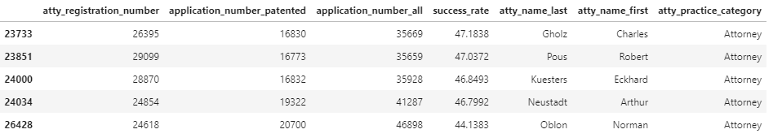
How to search the attorney’s success rate?
attorney_agent

Slide 28
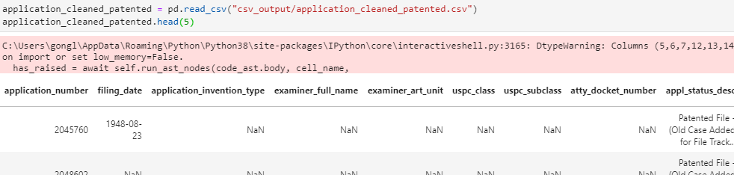
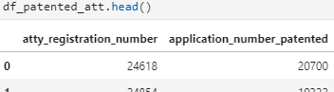
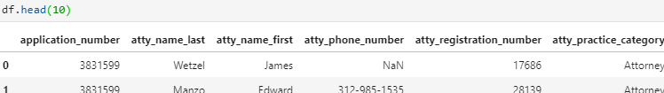
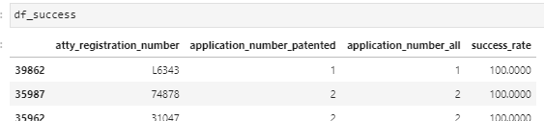
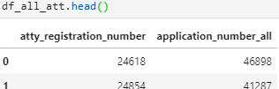
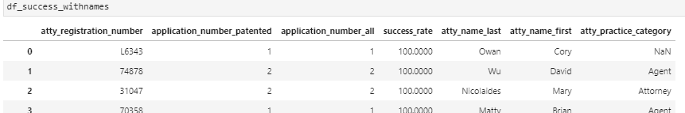
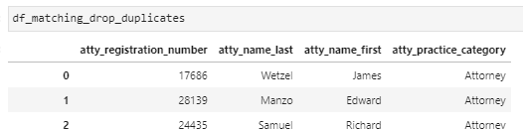
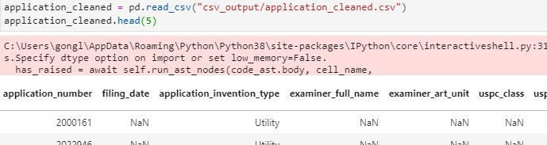
attorney_agent.csv
.csv generated from application_data.csv
on=["application_number"]
on=["application_number"]
.csv generated from application_data.csv
Road map to DataFrame: df_success_withnames
attorney_agent
Notes:
# some applications may not have been logged the attorney info

Slide 29
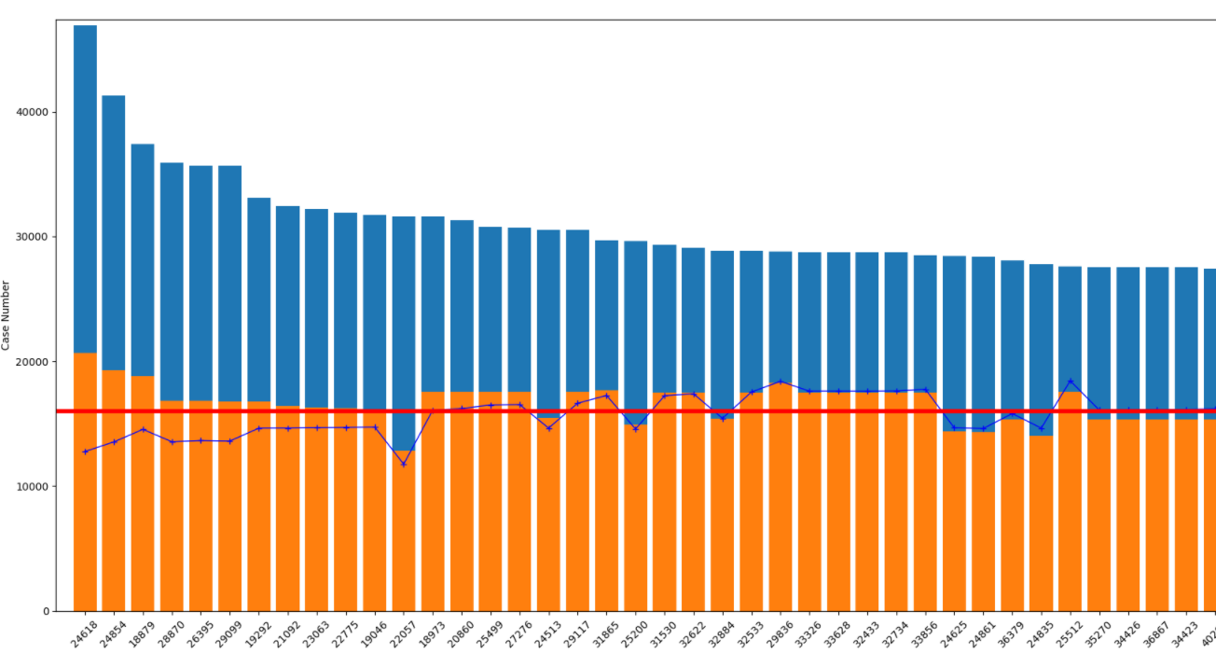
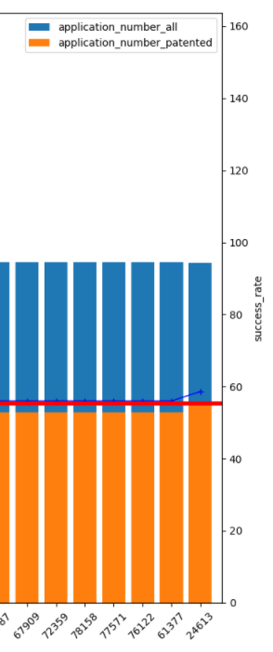
Which attorney would you want to pay to and deal with next few years?
Check out the success_rate for Top 100 attorneys who files most cases
attorney_agent
Notes:
I will choose the second one.

Slide 30
Make an App
One Step Further:
Are you looking for patent attorney? Take your risk!
Under interested class, which attorney has highest success_rate?
attorney_agent
Notes:
# previous slide was not grouped by uspc_class

Slide 31
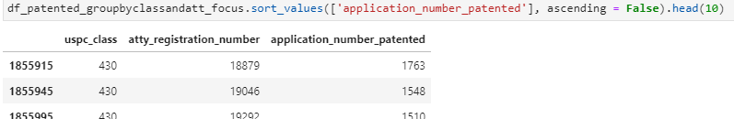
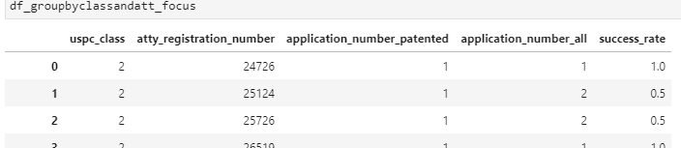
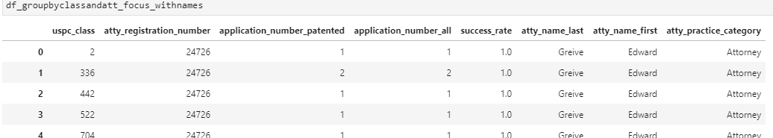
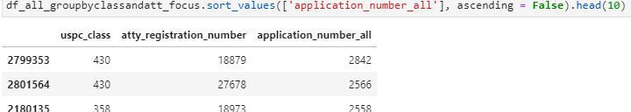
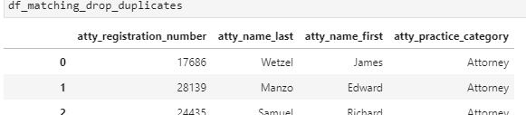
df_patented
on=['uspc_class', 'atty_registration_number']
df_all
Attorney info
attorney_agent

Slide 32
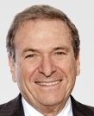
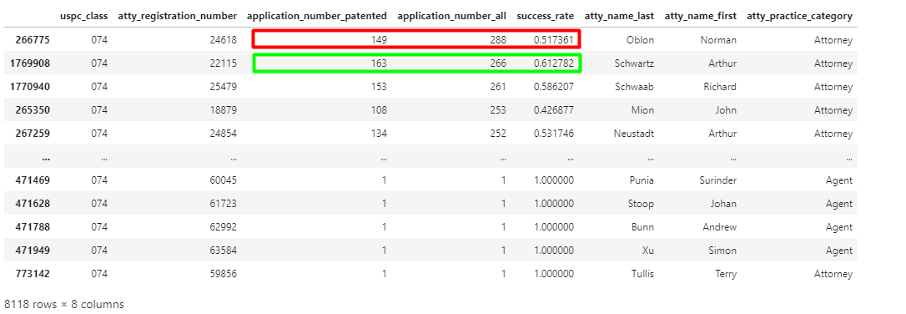
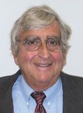
HesJustNotThatIntoYou App
your_interest = "074”, Machine element or mechanism
Which attorney would you want?
https://www.oblon.com/norman-f-oblon
http://laubscherlaw.com/our-firm/arthur-schwartz.html
attorney_agent
Notes:
# Even though Schwartz has fewer total application cases, he has 10% higher success rate than Oblon.
# And of course Oblon is much more famous and he runs a much bigger firm. Data speaks – I would go for Schwartz.

Slide 33
all_inventors
all_inventors

Slide 34


Which world regions apply most to USPTO based on inventors?
World Region Rank: US, Japan, Germnay, Korea, Taiwan, UK, Canada, France, China
all_inventors

Slide 35



Which US state apply most to USPTO based on inventors?
State Rank: CA, NY, TX, MA, NJ, PA, IL
all_inventors
Notes:
# Populated or ivy league area.
# Bad data input: San Diego. Yes could have pandas change it but should have made it right when inputting data.

Slide 36


API: from config import (census_key, gkey)
all_inventors

Slide 37





Correlation Checks
all_inventors
Notes:
Population, per capita income, poverty rate,

Slide 38

Heat Map for Inventors per State
all_inventors
Notes:
Conclusion: move to San Diego, Bay Area or Northeast Ivy League Area. RTP. TX for oil and gas.

Slide 39
Want to be surrounded by inventors? Want to make more $ filing patents?
all_inventors

Slide 40

Move to California!
all_inventors

Slide 41
patent_claims_stats
patent_claims_stats
Notes:
# Backgroud: Besides merely getting an application allowed, clients are also concerned about the quality and scope of their claims.
# One way to determine this is by measuring how well a law firm preserves claims through prosecution.

Slide 42


application_data.csv
patented_df
application_cleaned_patented.csv
on=["patent_number"]
patent_claims_stats.csv
groupby(['patent_number'])
p_word_ct = p.agg({"word_ct": "sum"})
claims_summary_df
p_char_ct = p.agg({"char_ct": "sum"})
Road map to DataFrame: claims_summary_df
patent_claims_stats
Notes:
Mention the loop method or use the .agg

Slide 43

claims_summary_df
For each distinct patent number:
patent_claims_stats
Notes:
RE45254 was shown at the beginning of the presentation as an example.

Slide 44


How many claims in one patent?
patent_claims_stats
Notes:
In a patent, the claims determine the exclusive rights granted to the patent owner. As such, the strength of a patent lies not only in the described invention, but also in its claims.
A patent with more claims is more likely to withstand challenges in an adversarial setting.
# right skew

Slide 45


How words in one claim?
patent_claims_stats

Slide 46


How many characters in one claim?
patent_claims_stats

Slide 47
25 claims in one patent 135 words in one claim 873 characters in one claim
What is the examiner’s comfort zone?
Golden Rule
patent_claims_stats

Slide 48
Summary
Would you afford the time cost?
Check out Hamlet App on Page 20
Is your case likely to be patented?
Check out Hamlet App on Page 20
Which attorney are you talking to?
Check out HesJustNotThatIntoYou App on Page 31
Would you want to live around other inventors?
If yes, move to CA, Ivy Leauge, RTP areas
Do you know the examiner’s comfort zone?
25, 135, 837 rules
Notes:
# hidden rule maybe: 25, 135, 837 rules

Slide 49
Copyright and Trademark Notice
All material in this presentation, including design, text, images, charts, are owned by Liang Gong, protected by US copyright and trademark laws. All rights are reserved by Liang Gong. Content may not be copied, reproduced, transmitted, distributed, downloaded or transferred in any form or by any means without Liang Gong's prior written consent, and with express attribution to Liang Gong. The only exception is that one temporary copy may be downloaded into a single computer's memory and one unaltered permanent copy may be used by the viewer for personal and non-commercial use only, with an attached copy of Liang Gong 's written consent. No part of the downloaded copy may be subsequently reproduced, disseminated or transferred. Copyright infringement is a violation of federal law subject to criminal and civil penalties. (For permission to reprint, please contact Liang Gong via email at gongliangtju@gmail.com)

Slide 50
Ready to buy Hamlet App and HesJustNotThatIntoYou App?
Questions?

Slide 51
Thank You

